Slide 1

Identifying a Digital Phenotype of COVID-19 high-risk Transmitters, Receivers, and Interactions using a robust University connectivity and metadata dataset
Bryn Loftness
Principles of Complex Systems Fall 2021
Project and Data associated to affiliation to Broad Institute of MIT and Harvard

Slide 2
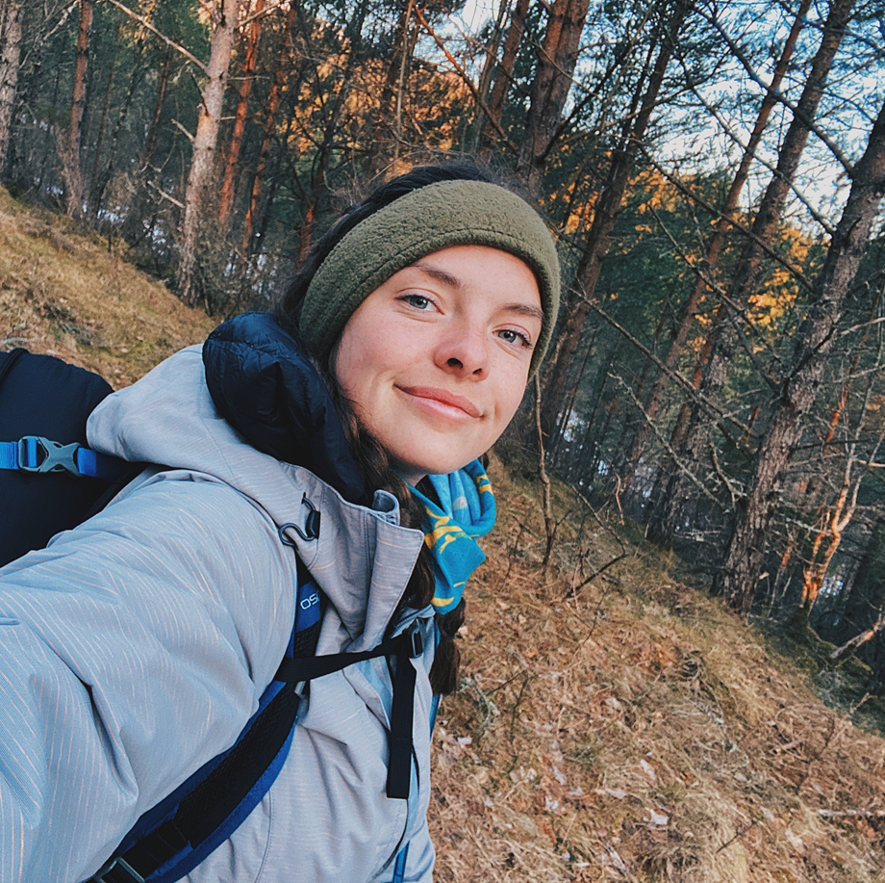
Brief Intro
Current Main Objectives:
1) Uncovering new trends and insights utilizing novel digital phenotyping algorithms on health-related data derived from wearable devices and health records
2) Engage in widespread STEM outreach to engage under-represented and younger populations
Born and Raised in Minnesota
Engineering/Computer Science/Health Background
BSc from Colorado Mesa University
Work with M-Sense Research Group and Neurobotics Lab
Complex Systems and Data Science PhD Program, advised by Dr. Nick Cheney, Dr. Ellen McGinnis, and Dr. Ryan McGinnis
Free-time Activities:
Art, Side Projects, Hiking, Travelling, Sports

Slide 3




Project Background
Dataset ranges from August 2020 - May 2021
Includes interaction data for any individual connected to University Wi-Fi in any on-campus location at any time of the day for interactions > 15 minutes
Data is related to on-going Broad Institute study for reconstructing the spread of COVID-19 on the CMU Campus through genomic, epidemiological, connectivity and robust metadata analysis

Slide 4
Research Question
Do unique combinations of features of “risky” individuals, receivers, or interactions exist that can be overlayed into on-going University connectivity systems as an added layer of outbreak response and contact tracing?
Notes:
Using Wi-Fi connectivity data from a 9-month period on a University campus, I examine if we can identify unique combinations of features for "risky" individuals, receivers, or interactions that define potential COVID-19 transmission events.

Slide 5
Details about the dataset
~1,300 positive cases at CMU in the Fall 2020-Spring 2021 year (9 months)
The dataset include 75,695,156 interactions
The individuals in this dataset can be cross-referenced back to COVID-19 positive records
Each interaction can then be categorized into P-P, P-N, N-N interactions
Of the ~75+ million interactions: 560,567 were P-N, 13,318 were P-P
Considering the infectious period to be 10 days (which is tweakable)…
of the P-P interactions, 549 unique positive individuals
of the P-N interactions, 890 unique positive individuals
We also have metadata on class-year, sports team, residence, gender, etc.

Slide 6
Progress and plan moving forward…
Pulled data from ~50+ files and combined them into large database
Cross-referenced IDs from Degree Analytics to CMU identifiers
Pulled in metadata about test data
Exported to a script in Python to begin categorization and parsing
Created data frame to hold data (3 times)
Created P-P, P-N, and N-N category groups in data structure to begin analysis
Preliminary metric analysis started
Planning for in-depth network analysis started
Deadline: Early December

